Slide 1
Colors for Digital Images

Slide 2
Primary Colors for Additive Color system:
RED
GREEN
BLUE

Slide 3
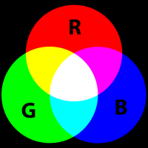
The RGB color model is additive in the sense that the three light beams are added together, and their light spectra add, wavelength for wavelength, to make the final color's spectrum.

Slide 4
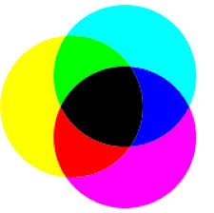
Subtractive Color
When we mix colors using paint, or through the printing process, we are using the subtractive color method. Subtractive color mixing means that one begins with white and ends with black; as one adds color, the result gets darker and tends to black.
The CMYK (Cyan, Magenta, Yellow, blacK) color system is the color system used for printing.

Slide 5
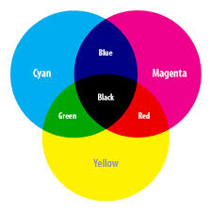
compare
Additive system
Subtractive system

Slide 6
cyan | #00FFFF | gray | #808080 | navy | #000080 | silver | #C0C0C0
black | #000000 | green | #008000 | olive | #808000 | teal | #008080
blue | #0000FF | lime | #00FF00 | purple | #800080 | white | #FFFFFF
magenta | #FF00FF | maroon | #800000 | red | #FF0000 | yellow | #FFFF00
This table shows the sixteen named colors defined in the HTML 4.01 specification . (Names are defined in this context to be case-insensitive; the table is alphabetically ordered.) Your knowledge
of Hexadecimal is important to understanding this!

Slide 7
HTML code with colors:
Open a browser and look at a web page.
View source and search for “color”:
http://www.w3schools.com/colors/colors_picker.asp ←example

Slide 8


Digital zoom on low resolution picture

